Slide 1
Evolution of Convolutional neural network

Slide 2
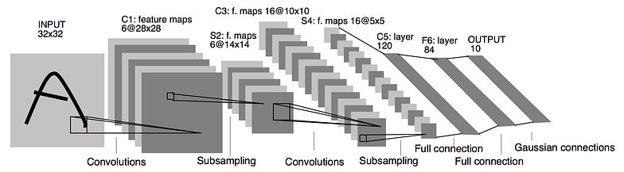
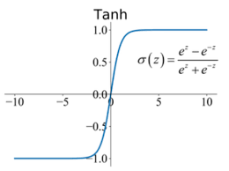
Convolutional neural network
Le-net-5 (1998)
Architecture:
7 layers architecture
Convolution: Preserve spatial orientation
LeNet-5 was used on large scale to automatically classify hand-written digits on bank cheques in the US
Disadvantages
(i) The hidden layer used a tanh function which uses exponential operation. So, complexity is more for the network. This increases training time. Due to vanishing gradient problem there is loss of data.
(ii) Small in architecture
(iii) No normalization concept
(iv) Same kernel size of 5*5 .
(v) Not capture all details

Slide 3

ImageNet Large Scale Visual Recognition Challenge competition start
Convolutional neural network (2009)
Revolution of ImageNet dataset
We decided we wanted to do something that was completely historically unprecedented,” Li said, referring to a small team who would initially work with her. “We’re going to map out the entire world of objects.” (2009)
Stanford professor and Google Cloud chief scientist Fei-Fei Li changed everything.

Slide 4
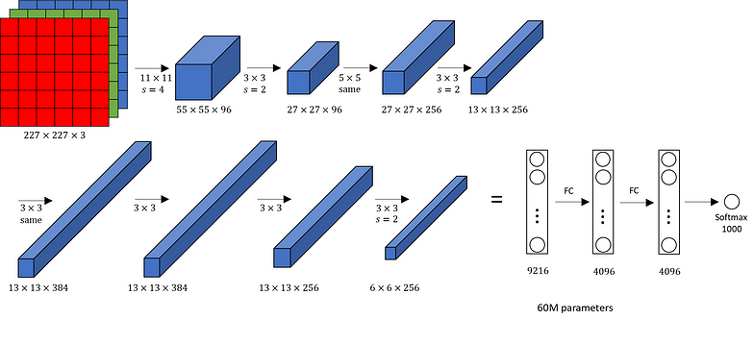
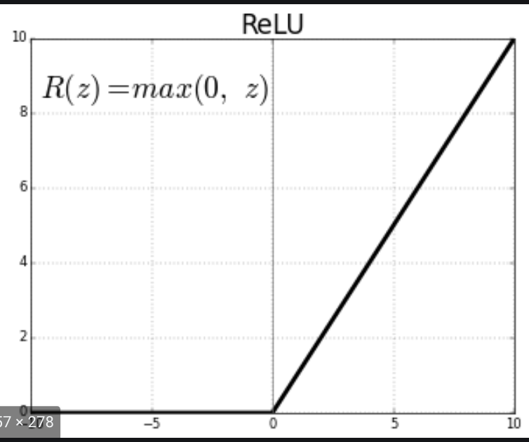
Convolutional neural network
AlexNet[2012] :
RGB images
5 convolution layers ( 3×3),
3 max-pooling layers (translation invariance),
2 Normalized layers,
2 fully connected layers and
1 SoftMax layer.
Used GPU
Large parameters (Large memory requirements, overfit)
This was the first architecture that used GPU to boost the training performance
Each convolution layer consists of a convolution filter and a non-linear activation function called “ReLU” (rid of vanishing gradient problem)

Slide 5
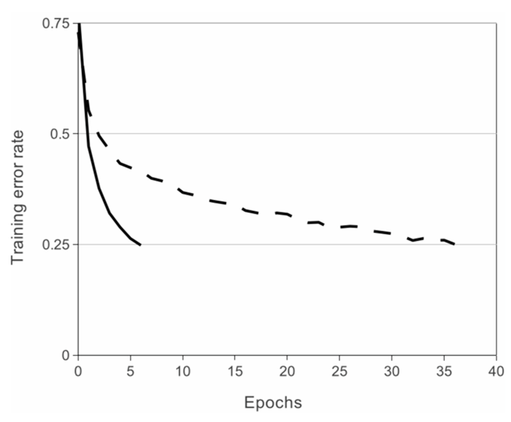
Convolutional neural network
AlexNet[2012] :
relu (solid line)
tanh (dot line)
Augmentation
Droupout
Local Normalization
Relu is six times faster [60M]
Good that time but shallow network

Slide 6
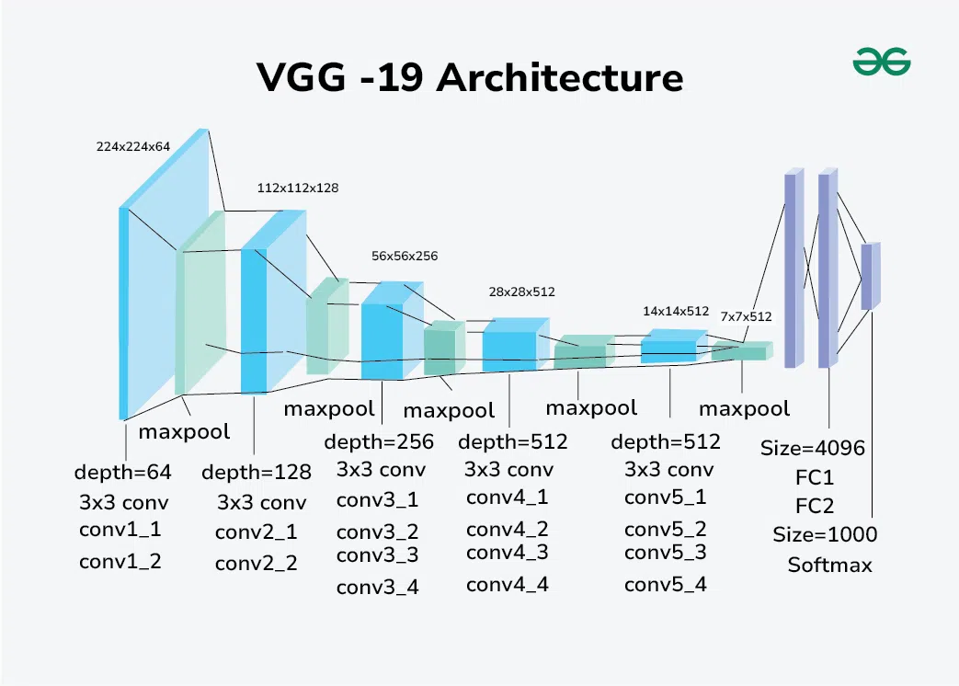
Convolutional neural network
Vgg [2014]
1. The VGG network introduced the concept of grouping multiple convolution layers with smaller kernel sizes instead of having one Conv layer with a large kernel size.
2 .mini-batch gradient descent based on backpropagation.
Different configurations (universal pattern, differ only in depth):
11 weight layers in network (8 conv and 3 fc) to 19 weight layers in network (16 conv and 3 fc).
The number of channels of convolutional layers is rather small, starting from 64 in the first layer and then increasing by a factor of 2 after each max-pooling layer, until reaching 512
5 x 5 equal to two 3 x 3

Slide 7
Convolutional neural network
Vgg [2014]
Disadvantages
One major disadvantage that I found was that this model experiences the vanishing gradient problem.
Takes more times (slow train)
Overfitting is possible, especially when dealing with small datasets.
138 million parameters lead to exploding gradients problem.

Slide 8
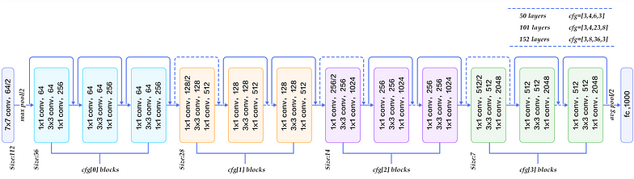
Convolutional neural network
Resnet [2015]
Universal approximation theorem : go deeper

Slide 9
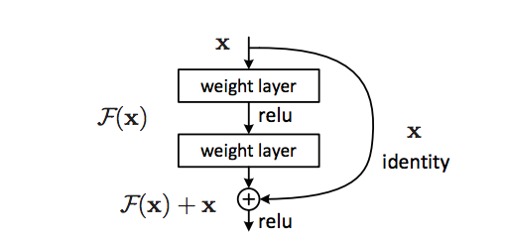
Convolutional neural network
Resnet [2015]
Lower complexity
Short cut by pass, introduce to reduce vanishing gradient problem
Won’t harm performance
Batch normalization (internal covariate shifting, model faster)
Deep resnet at least as good as shallower one
Plain network with by pass has no extra parameter
This allows:
Train deep neural network with high LR
Less dependency on random initial weight
Skip connection

